Slide 1
Chapter 6
Attitudes

Slide 2
The Study of Attitudes
Attitudes: A positive, negative, or mixed reaction to a person, object, or idea
  *Attitudes cannot simply be represented along a single continuum ranging from wholly positive to wholly negative!*
Attitude formation process is often quick, automatic, and “implicit.”

Slide 3
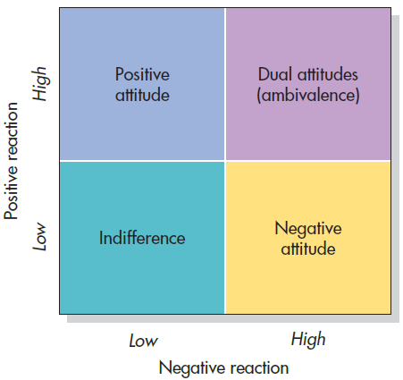
Four Possible Reactions to Attitude Objects
Notes:
Figure 6.1 Four Possible Reactions to Attitude Objects As shown, people evaluate objects along both positive and negative dimensions. As a result, our attitudes can be positive, negative, ambivalent, or indifferent. Cacioppo et al. (1997)

Slide 4
How Attitudes Are Measured
Self-report measures
  Attitude scale
Covert measures
  Videotape
  Facial electromyography (EMG)
  Brain imaging
Implicit Association Test (IAT)

Slide 5
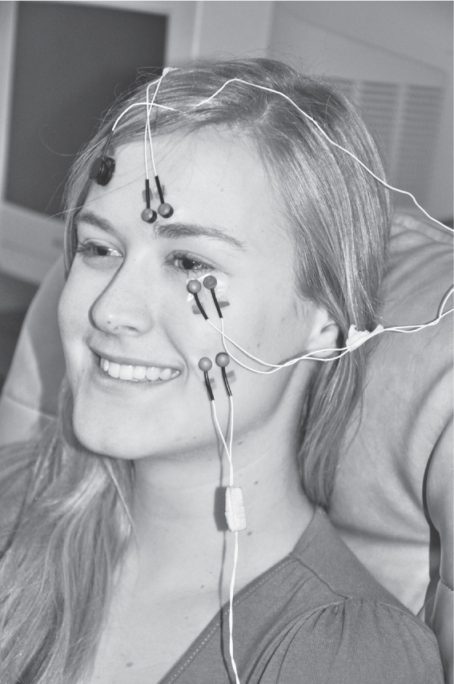
Facial Electromyography
Measures muscle fiber activation in the face
  Different muscles activate when feel different emotions
  Muscles used in facial expressions!
Levels of activation can betray what we are feeling!

Slide 6
How Attitudes Are Formed?
Genetic? Strong likes and dislikes might be hereditary
Our most cherished attitudes often form as a result of:
  Exposure to attitude objects (mere exposure effect)
  Rewards and punishments (Conditioning)
  Attitudes that our parents, friends, and enemies express (socialization)

Slide 7
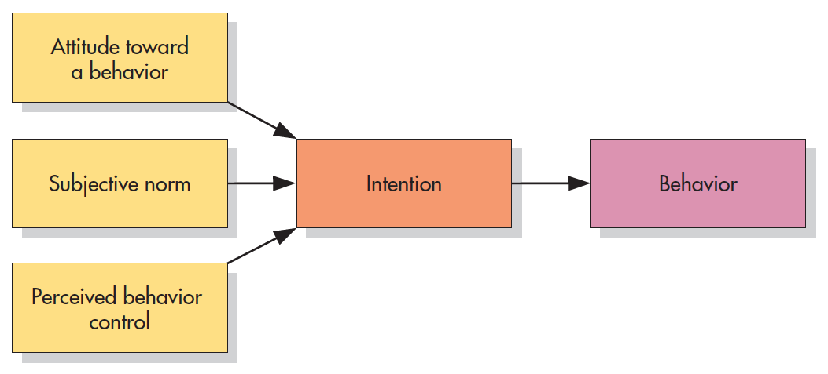
Theory of Planned Behavior
Attitudes influence our behavior!
Notes:
Figure 6.5 Theory of Planned Behavior According to the theory of planned behavior, attitudes toward a specific behavior combine with subjective norms and perceived behavior control to influence a person’s intentions. These intentions, in turn, guide but do not completely determine behavior. This theory places the link between attitudes and behavior within a broader context.
From Ajzen, Organizational Behavior and the Human Decision Process vol. 50 pp. 179–211. Copyright © 1991 Elsevier. Reprinted with permission.

Slide 8
Changing attitudes
Persuasion is the process by which attitudes are changed.
The dual-process model of persuasion assumes that we do not always process communications the same way
  Central route to persuasion
  Peripheral route to persuasion

Slide 9
The Central Route
A person thinks carefully about a communication and is influenced by the strength of its arguments.
  Elaboration
  Self-validation hypothesis
    Only thoughts that people perceive as valid will shape their behavior!
Persuasive communication with positive or negative attitude-relevant thoughts but also seek to assess the validity of these thoughts

Slide 10
The Peripheral Route
The process by which a person does not think carefully about a communication and is influenced instead by superficial cues.
Simpleminded heuristics
Attitude embodiment effects
  Person’s experiences physiological changes that shape how they perceive something (e.g., emotional arousal)

Slide 11
Route Selection
Which route we use depends on whether we have the ability and the motivation to take the central route.
The way a recipient processes a persuasive communication depends on three factors.

Slide 12

Route Selection
Source—who is presenting the message
Message—says what and in what context
Audience—to whom the message is directed

Slide 13
Which Route?
Credibility
  Competence
  Trustworthiness
Likability
  Similarity
  Physical attractiveness

Slide 14
Who Do You Trust?
Occupation | % Very high/High
Nurses
Medical doctors
Pharmacists
High school teachers
Police officers
Real estate agents
Lawyers
Business executives
Telemarketers
Car salespeople
Members of Congress
Notes:
Table 6.1 Who Do You Trust? Please tell me how you would rate the honesty and ethical standards of people in these different fields—very high, high, average, low, or very low?
In December 2018, a Gallup poll was conducted to determine the level of honesty attributed to people from various occupational groups. Indicated alongside are the percentages of respondents who rated each group as “high” or “very high” in honesty.

Slide 15
Who Do You Trust?
Occupation | % Very high/High
Nurses | 84
Medical doctors | 67
Pharmacists | 66
High school teachers | 60
Police officers | 54
Real estate agents | 25
Lawyers | 19
Business executives | 17
Telemarketers | 9
Car salespeople | 8
Members of Congress | 8
Notes:
Table 6.1 Who Do You Trust? Please tell me how you would rate the honesty and ethical standards of people in these different fields—very high, high, average, low, or very low?
In December 2018, a Gallup poll was conducted to determine the level of honesty attributed to people from various occupational groups. Indicated alongside are the percentages of respondents who rated each group as “high” or “very high” in honesty.

Slide 16
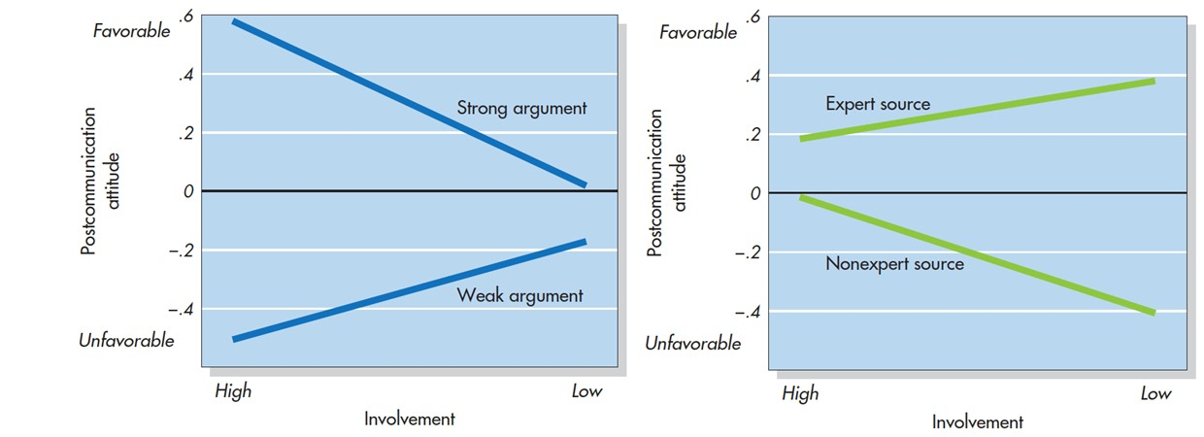
Source Versus Message: The Role of Audience Involvement
Argument strength
Source Type
Notes:
Figure 6.8 Source Versus Message: The Role of Audience Involvement People who were high or low in their personal involvement heard a strong or weak message from an expert or nonexpert. For high-involvement participants (left), persuasion was based on the strength of arguments, not on source expertise. For low-involvement participants (right), persuasion was based more on the source than on the arguments. Source characteristics have more impact on those who don’t care enough to take the central route. Reprinted by permission from Richard E. Petty.

Slide 17
The Sleeper Effect
Sleeper effect: A delayed increase in the persuasive impact of a non-credible source.
Discounting cue hypothesis: People immediately discount the arguments made by non-credible communicators, but over time, they dissociate what was said from who said it.

Slide 18
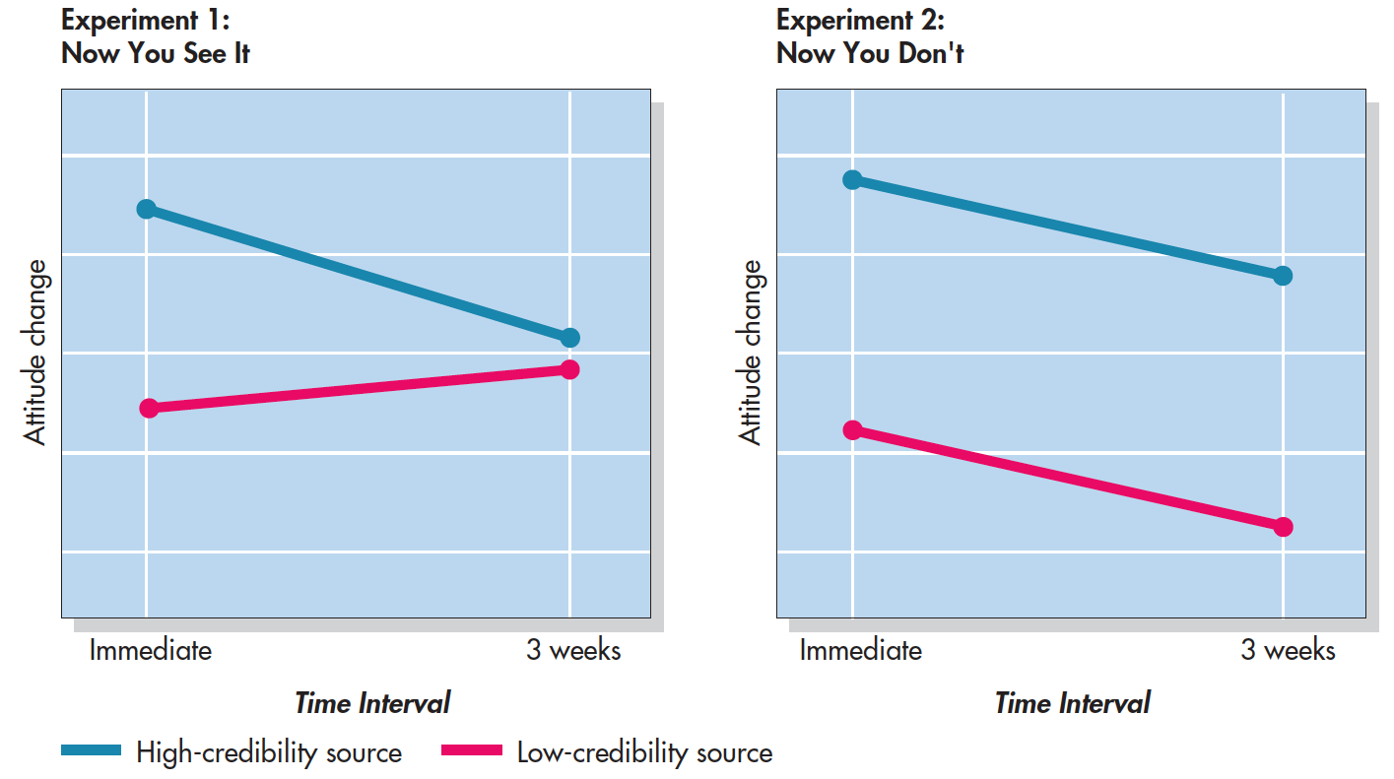
The Sleeper Effect (Kelman & Hovland, 1953)
No reminder after 3 weeks
Reminder after 3 weeks
Notes:
Figure 6.9 The Sleeper Effect In Experiment 1, participants changed their immediate attitudes more in response to a message from a high-credibility source than from a low-credibility source. When attitudes were measured again after 3 weeks, the high-credibility source had lost impact, and the low-credibility source had gained impact—the sleeper effect. In Experiment 2, the sleeper effect disappeared when participants were reminded of the source. Kelman & Hovland, 1953

Slide 19
Informational Strategies
Most effective strategy depends on whether the audience process the message on the central or peripheral route.
Length of a communication
  Central process: Quality of the argument is more important than length.
  Peripheral processing often uses simple heuristic:
  “The longer the message, the more valid it must be.”
Primacy versus recency effect
  Time is a critical factor.

Slide 20
Message Discrepancy
How discrepant should a message be from the audience’s position in order to have the greatest impact?
  Exercise caution—avoid outright rejection of the message by avoiding too much change at once.
The more personally important an issue is to us, the more stubborn and resistant to change we become.

Slide 21
Appeals to Emotion
Persuasion efforts should be aimed at the heart rather than through the mind.
Language used in each participant’s appeal by measuring the use of high-emotionality words—such as amazing, awful, loved, and hated.
Our tendency to express more emotion when trying to persuade happens spontaneously.

Slide 22
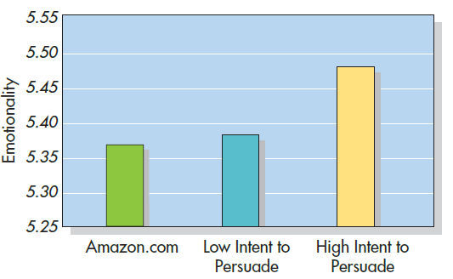
Appeals to Emotion (Rocklage et al., 2018)
Notes:
Figure 6.10 Research participants were asked write an online review of a consumer product. Half the participants were instructed to write a positive five-star review; the others were told that the goal was to persuade readers to purchase the product. Compared to actual reviews posted on Amazon.com, participants aiming to persuade used more emotional language in their reviews Rocklage et al., 2018

Slide 23
Fear Appeals
Fear arousal increases the incentive to change for those who do not actively resist it
  Impact depends on the strength its arguments and whether the message also contains clear and reassuring advice on how to cope with the threatened danger.
Without specific instructions on how to cope, people feel helpless, panic, and tune out the message.

Slide 24
Why are Positive Emotions so important for persuasion?
When people are in a good mood, they become more:
  Sociable
  Generous
  Positive in their outlook
Positive feelings activate the peripheral route to persuasion, facilitating change and allowing superficial cues to take on added importance.

Slide 25
Subliminal Messages
Commercial messages outside of conscious awareness
Controlled experiments using subliminal self-help materials offer no therapeutic benefits
People may respond to subliminal cues in the short term when they are already motivated to take the action

Slide 26
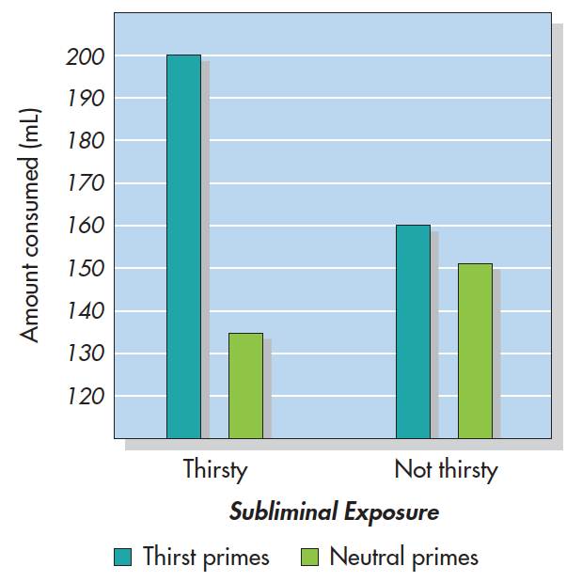
Subliminal Influence (Strahan et al, 2002)
Thirsty vs. non-thirsty participants
All subliminally exposed to thirst related words or neutral words
Afterwards, they completed a drink taste test
Who drank more?
Notes:
Figure 6.11 Subliminal Influence Thirsty and non-thirsty research participants were subliminally exposed to neutral or thirst-related words. Afterward, they participated in a beverage taste test in which the amount they drank was measured. You can see that the subliminal thirst cues had little impact on non-thirsty participants but that they did increase consumption among those who were thirsty. Apparently, subliminal cues can influence our behavior when we are otherwise predisposed. Strahan et al., 2002

Slide 27
The Audience (1 of 2)
Need for cognition (NC)
  A personality variable that distinguishes people based on how much they enjoy effortful cognitive activities.

Slide 28
Need for Cognition (NC) Scale: Sample Items
I really enjoy a task that involves coming up with new solutions to problems.
Thinking is not my idea of fun.
The notion of thinking abstractly is appealing to me.
I like tasks that require little thought once I’ve learned them.
I usually end up deliberating about issues even when they do not affect me personally.
It’s enough for me that something gets the job done; I don’t care how or why it works.
Notes:
Table 6.3 Need for Cognition Scale: Sample Items Are you high or low in the need for cognition? These statements are taken from the NC Scale. If you agree with items 1, 3, and 5 and disagree with items 2, 4, and 6, you would probably be regarded as high in NC.
From Cacioppo, J. T. and Petty, R. E., “The need for cognition,” Journal of Personality and Social Psychology, vol. 42 (pp. 116–131). Copyright © 1982 by the American Psychological Association. Reprinted by permission.

Slide 29
The Audience (2 of 2)
Self-monitoring
  Regulating own behaviors across situations due to concern for public self-presentation
Regulatory fit
  Promotion-oriented versus prevention-oriented
  Positive versus negative approach
Cognitive Dissonance
  Changing thought processes/attitudes to fit one’s self-image

Slide 30
Cognitive Dissonance Theory: The Classic Version
Theory holding that inconsistent cognitions arouses psychological tension
  People are then motivated to reduce this tension!
Conditions for cognitive dissonance:
  An attitude-discrepant behavior was chosen freely and with some knowledge of the consequences
  “Acting out of character”

Slide 31
Ways to Reduce Dissonance
Techniques | Examples
Change your attitude. | “I don’t really need to be on a diet.”
Change your perception of the behavior. | “I hardly ate any ice cream.”
Add consonant cognitions. | “Chocolate ice cream is very nutritious.”
Minimize the importance of the conflict. | “I don’t care if I’m overweight---life is short!”
Reduce perceived choice. | “I had no choice; the ice cream was served for this special occasion.”
Notes:
Table 6.4 Ways to Reduce Dissonance “I need to be on a diet, yet I just dove head first into a tub of chocolate fudge brownie ice cream.” If this were you, how would you reduce dissonance aroused by the discrepancy between your attitude and your behavior?

Slide 32
Justifying Attitude-Discrepant Behavior
Cognitive dissonance and attitude change are more likely to occur when there is insufficient justification or insufficient deterrence for an attitude-discrepant non-behavior.
Festinger and Carlsmith (1959)
  Classic study on dissonance
https://www.youtube.com/watch?v=1kmVy1QPXn0

Slide 33
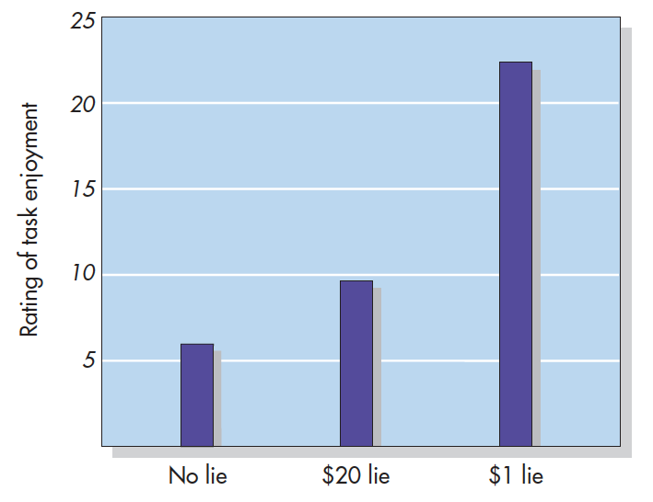
Festinger & Carlsmith (1959)
Notes:
Figure 6.12 The Dissonance Classic Participants in a boring experiment (attitude) were asked to say that it was enjoyable (behavior) to a fellow student. Those in one group were paid $1 to lie; those in a second group were offered $20. Members of a third group, who did not have to lie, admitted that the task was boring. So did the participants paid $20, which was ample justification for telling a lie. Participants paid only $1, however, rated the task as more enjoyable. Behaving in an attitude-discrepant manner without justification, these latter participants reduced dissonance by changing their attitude. Based on Festinger, L. and Carlsmith, J. M., “Cognitive Consequences and Forced Compliance,” Journal of Abnormal and Social Psychology vol. 58 (pp. 203–210). Copyright © 1959 by the American Psychological Association. Reprinted by permission.

Slide 34
Justifying Difficult Decisions: When Good Choices Get Even Better
People rationalize whatever they decide by exaggerating the positive features of the chosen alternative and the negative features of the unchosen alternative.

Slide 35
Cognitive Dissonance Theory: A New Look (1 of 2)
Four steps are necessary for both the arousal or reduction of dissonance (Cooper and Fazio, 1984):
  An attitude-discrepant behavior must produce unwanted negative consequences
  A feeling of personal responsibility for the unpleasant outcomes of behavior

Slide 36
Cognitive Dissonance Theory: A New Look (2 of 2)
  Physiological arousal that produces a state of discomfort and tension that the person seeks to reduce
  A person must make an attribution for that arousal to his or her own behavior

Slide 37
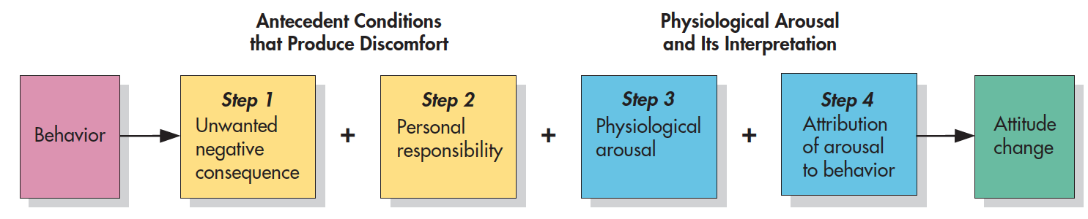
Necessary Conditions for the Arousal and Reduction of Dissonance
Notes:
Figure 6.13 Necessary Conditions for the Arousal and Reduction of Dissonance Research suggests that four steps are necessary for attitude change to result from the production and reduction of dissonance.

Slide 38
Alternative Routes to Self-Persuasion
Self-perception theory
  We infer how we feel by observing ourselves and the circumstances of our own behavior
Impression-management theory
  What matters is not a motive to be consistent but rather a motive to appear consistent
Self-esteem theories
  Acts that arouse dissonance do so because they threaten the self-concept

Slide 39
Ethical Dissonance (1 of 2)
Behavioral ethics
  The study of how individuals behave when facing temptations to cheat, steal, plagiarize, commit fraud, lie, or otherwise behave unethically.
Two types of problems have been addressed:
  Unintentional lapses in ethics
  Intentional wrongdoing that people commit in order to serve their own interests
  Behaving in ways that violate our own moral code threatens self-esteem and arouses inner state of turmoil!

Slide 40
Ethical Dissonance (2 of 2)
Pre-violation and post-violation justifications:
  Blaming others or circumstances
  Rationalizing
  Confessing, apologizing, and offering compensation
  Distancing themselves from the misdeed by asserting ethical standards for the future and judging other transgressors more harshly.

Slide 41
Cultural Influences on Cognitive Dissonance
Cultural context may influence both the arousal and the reduction of cognitive dissonance:
  Western (individualist) cultures: Decisions are expected to be consistent with personal attitudes
  East Asian (collectivist) cultures: Decisions are expected to benefit ingroup members
Post-decision justification effect occurs in both groups, but cultures influence the conditions under which these processes occur.

